Slide 1
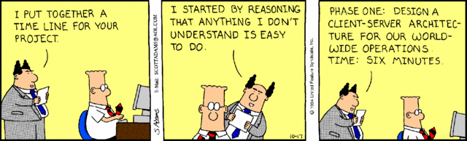
Software Engineering D7032E
Teacher: Josef Hallberg

Slide 2

About me
Josef Hallberg, PhD
Associate Professor in Pervasive and Mobile Computing
Research interests:
Smart homes
E-health
Gamification
Room: A2403
Phone: 0730 70 55 95
Mail: josef.hallberg@ltu.se

Slide 3
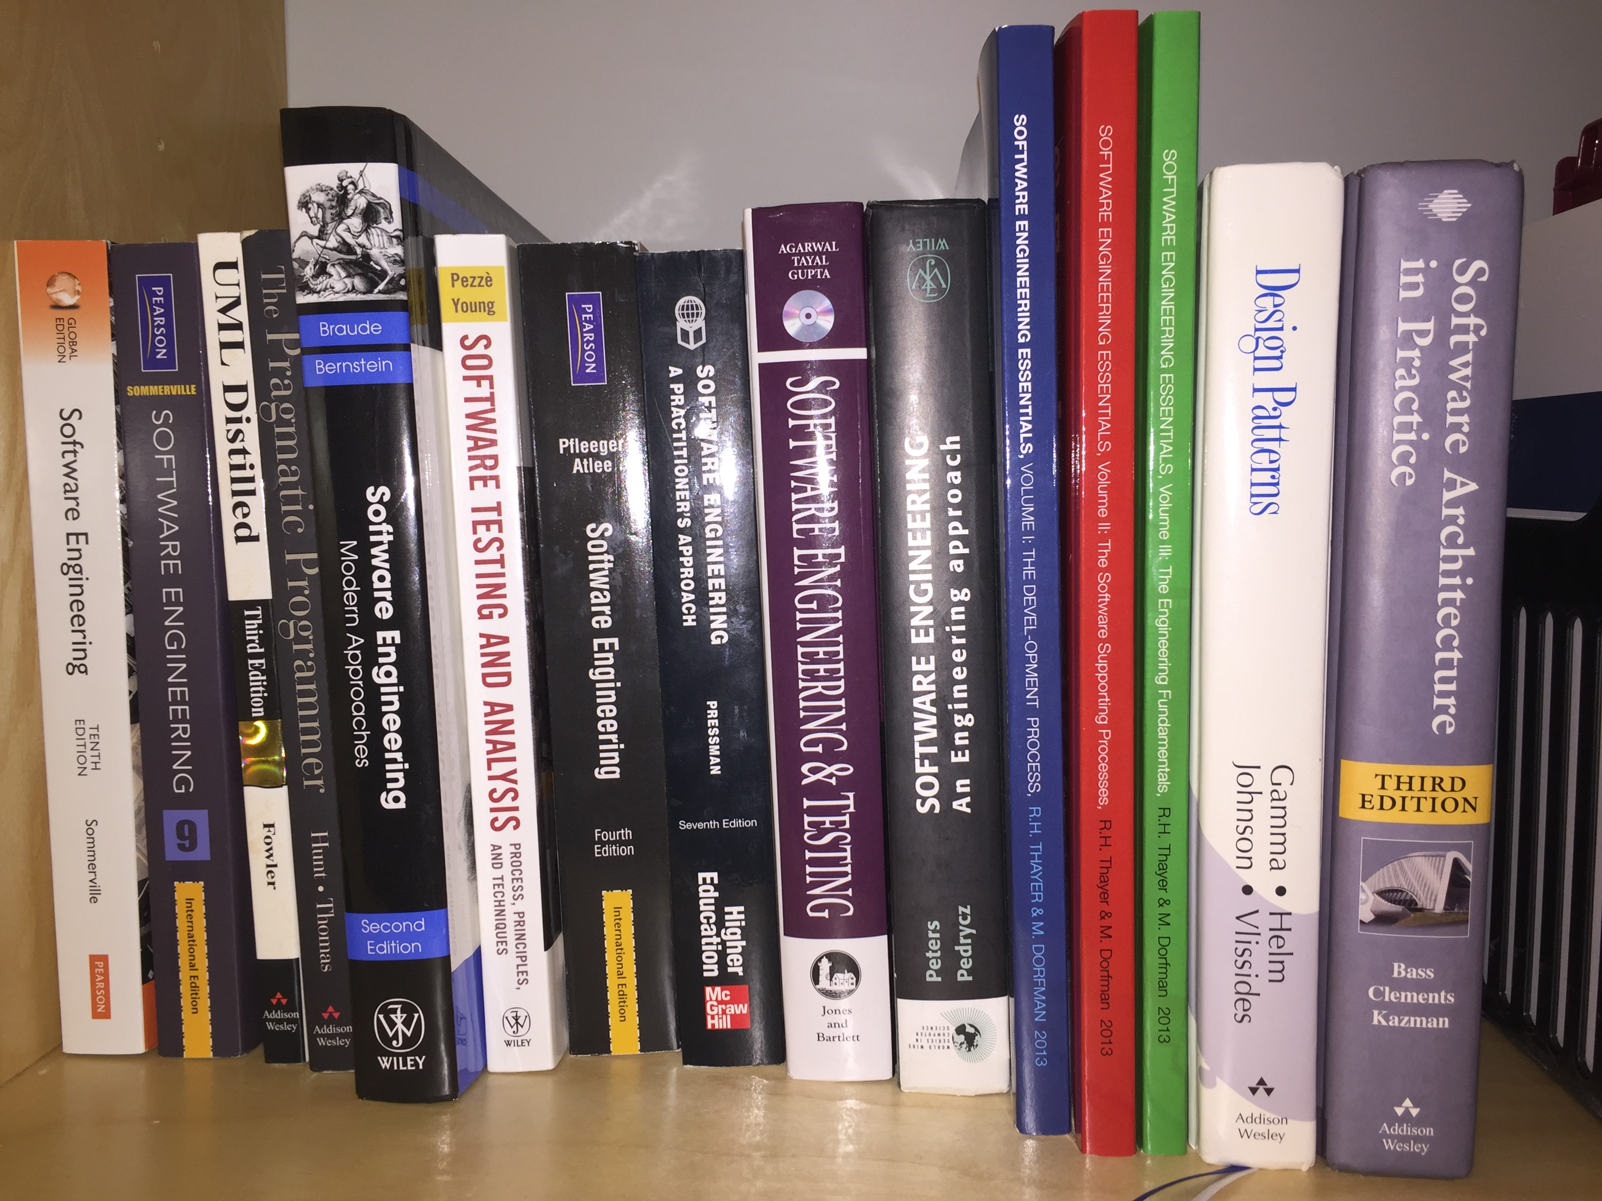

Slide 4
Outline of this course
Practical Software Engineering
Software Architecture
Quality Attributes
Working with large software
Tools-of-the-trade
Best practices

Slide 5
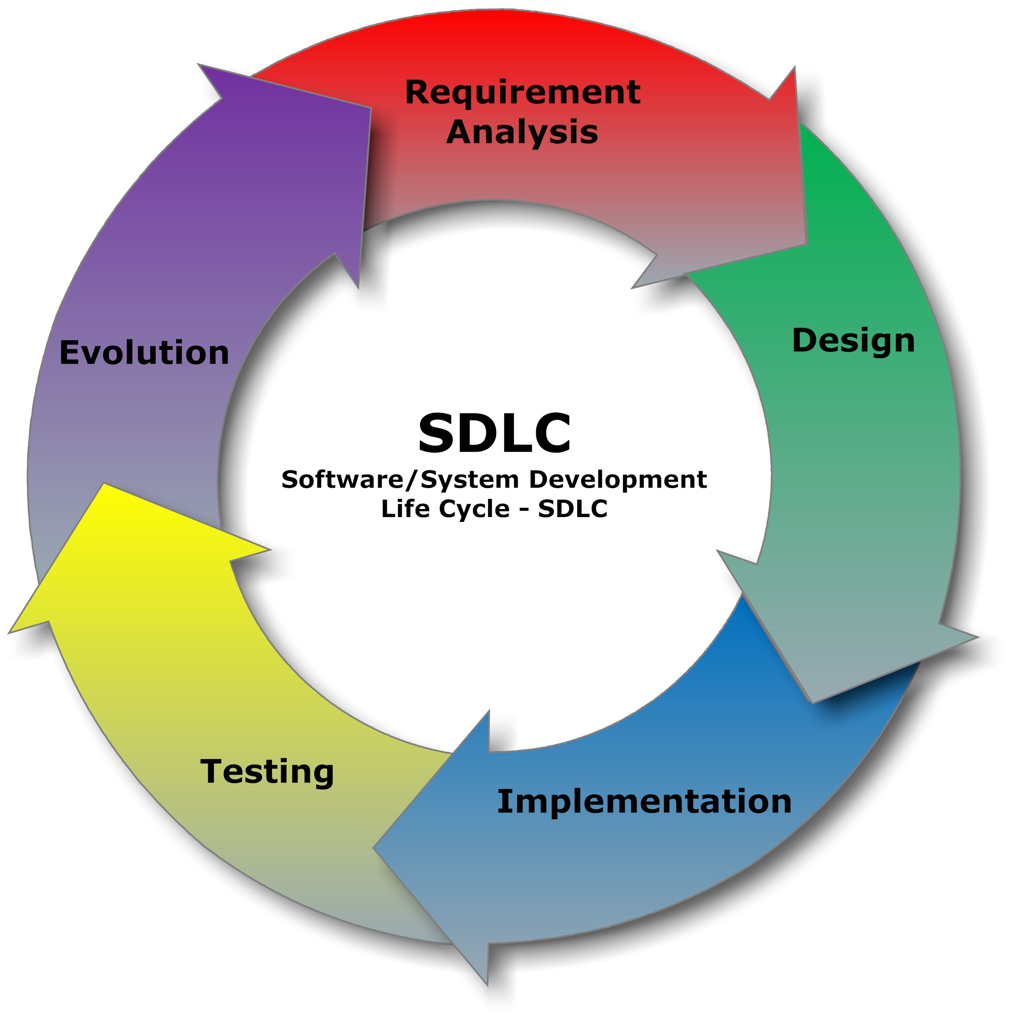
Software development lifecycle

Slide 6
Aims of this course
To turn you into capable software engineers
Understand and able to design good software architectures
Able to work with large software projects
Able to work in large scale development teams
Able to maintain high standard/quality of code
Understand the importance of software engineering principles

Slide 7
My qualifications
Worked in large/distributed teams
As programmer
As manager
Designed software architectures
For distributed teams
With different quality attributes
Flexibility, modifiability, scalability, performance
For distributed development
Suffered the frustration
Learned from my mistakes

Slide 8
Why you should attend…
Lectures
Chance to discuss and learn from each other
Examples and experiences
Importance and focus
Workshops
Practical experience
Collaboration and understanding other viewpoints
Making it real
Assignments
Designed to give practical experience on course content
Designed to engage and motivate

Slide 9
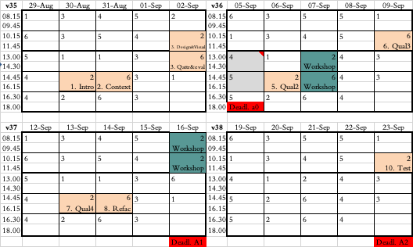

Slide 10
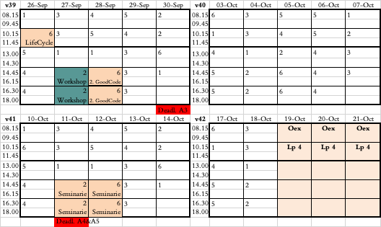
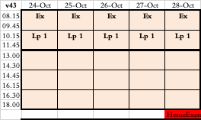

Slide 11
Course evaluation Course development report

Slide 12
Changes and Prerequisites
On

Slide 13
On assignments
Don’t rush finding a good project. Take your time, pick something you’ll learn from.
Assignment instructions: If something is unclear – ask.
Report structure: Not super important, just cover the requested material

Slide 14
On Workshops
Voluntary but often very appreciated
If you show up for the first workshop then please also show up for the second
(the third is independent of the first two)

Slide 15
On Lectures
More examples for quality attributes
Still working on improving
Self-study of design patterns…?
I personally wish we can have more discussions…

Slide 16
On HomeExam
Will release shortly (Exploding Kittens)
Estimated time to complete: 80 hours
Working on the HomeExam from the start?
Iterations - likely to be good for learning
Relevant discussions on lectures

Slide 17
HomeExam and collaboration
I do not care when you attain the knowledge
As long as what you hand in represents YOUR knowledge
Collaboration is permitted
Discuss structure BUT write the code yourself
Discuss design BUT produce the design diagrams / descriptions yourself
Discussion is fine, but do the work yourself!

Slide 18
Pre-requisites
Courses of at least 90 credits at first cycle including the following knowledge/courses.
D0009E Introduction to programming
D0010E Object-oriented programming and design
D0012E Algorithms and data structures.
But I want you to know basic Software Engineering (D0020E)

Slide 19
Course information
https://ltu.instructure.com/login

Slide 20
I would like discussions
I encourage you to ask questions
I will try to prepare questions to discuss
Beehive discussions 2-3 people
Learn from each other
Discussions related to the HomeExam?

Slide 21
Assignments
Made to reflect the content
Understand a design and implications of design choices
Identify and understand design-patterns
Identify stakeholders and requirements
Design a feature according to requirements
Implement a feature according to a design
Version control
Create test-cases and verify functionality
Document code

Slide 22
Assignments
Registration and Project selection:
Groups of 2-3 people (3 preferred)
Select a GitHub project to work on
> 200 forks, Automated test suite, Something that inspires you
Make sure there is a feature/change request you can implement
Understanding software design
Implement Change/Feature request
Design patterns
Automated tests
Presentation and demo
Home Exam

Slide 23
Examination
Assignments: Pass or Fail
Home Exam: Fail, 3, 4, 5
Do not cheat
Always reference/cite source material
Collaboration is fine, but provide your own answers

Slide 24
Mail filtering
I will use D7032E in the subject, please do the same
For the Registration assignment:
please add the email of all members in the TO or CC fields.
Make sure your group name is in the subject.
I may reply to this email with my feedback

Slide 25
Overview of software engineering

Slide 26
Software development lifecycle

Slide 27
Design

Slide 28
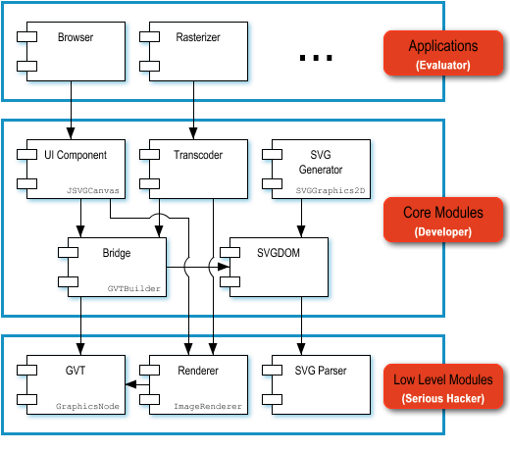
Design – Software Architecture
Module structures
Responsibilities of each module?
What access to other software elements?
Dependencies?
Relationships?

Slide 29
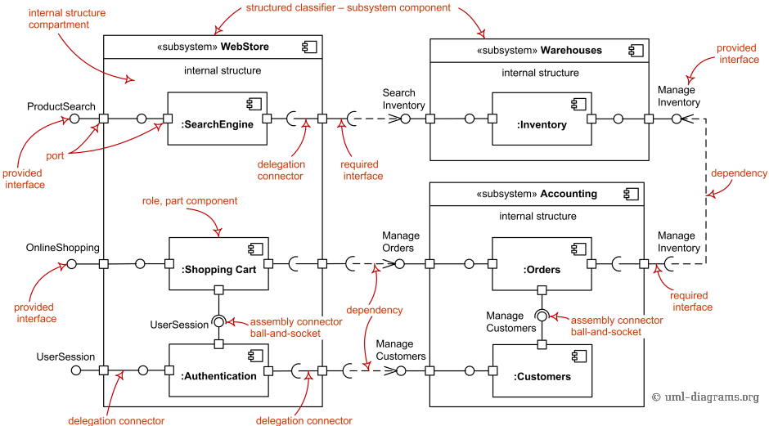
Design – Software Architecture
Component-and-connector structures
Major executing components and interaction at runtime?
Major shared data stores?
Progress through the system?
What can run in parallel?
Dynamic behavior? Changes at runtime?

Slide 30
Design – Software Architecture
Allocation structures
What processor does elements execute on?
In what directories or files are things stored?
What software elements are assigned to which team?

Slide 31
Discussion points
What aspects should be considered when designing a software architecture?
What is the role of a software architect?
Why is software architecture important?

Slide 32
Quality Software, On Time, and Within Budget

Slide 33
Why is software architecture important?
Will inhibit or enable driving quality attributes
Allows management of change as it evolves
Early prediction of a system’s qualities
Enhance communication among stakeholders
Fundamental design decisions
Constraints on subsequent implementation
Dictates the structure of an organization
Basis for evolutionary prototyping

Slide 34
Why is software architecture important?
Allows reasoning about cost and schedule
Transferable, reusable model that form the heart of a product line
Assembly of components, rather than simply on their creations
Channels the creativity of developers, reducing design and system complexity
Foundation for training a new team member

Slide 35
Implementation

Slide 36
Implementation
Understanding a design
Version management
Configuration management
Error handling
Coding / Debugging / Testing
Documentation

Slide 37
Why is Versioning /
Configuration Management important?

Slide 38
Software Configuration Management (SCM)
Changes that are made to the requirements drive the design
Designchanges affect the code

Slide 39
Motivation
What if a fully tested program doesn’t work?
What if a difficult bug that was fixed reappears?

Slide 40
Without control
Simultaneous updates
Shared code
Common code
Versions
Problems
Leads to wasting an enormous amount of time

Slide 41
Control the system
To answer the questions
What is my current software configuration?
What is its status?
How do I control changes to my configuration?
What changes have been made to the software?
Do anyone else’s changes affect my software?
What tests go together with this version?

Slide 42
Configuration Management Overview
Initial development
Requirements / Design / Use
Establish / Update Baseline
Approve change
Validate Baseline
Authorize change
Implement change
Validate change
Baseline
Changes

Slide 43
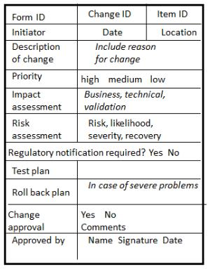
Change Request Form

Slide 44
Configuration Control
Only one official copy of the code
Baseline
Not the same as version management
Changes to the baseline must be approved

Slide 45
The version confusion
“The user-interface crashes when I press this button”
“But you told me you added this feature… I don’t see it”
“There is an interface mismatch between these components”

Slide 46
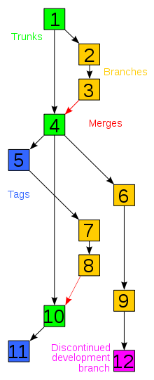
Versioning
Revisions
saved changes
Branches
the main projects is branched to enable simultaneous development
Merge
a point where branches are merged to form a new baseline
Trunk (subversion) = Master (Git)
The main branch of the project
Baseline = Labels = Tags
An approved version for all to work on
Notes:
Checkout, Commit, Conflict - Resolve, Delta compression (only retain the differences between successive versions of files), Repository where the current historical data is stored, working copy (local copy)

Slide 47
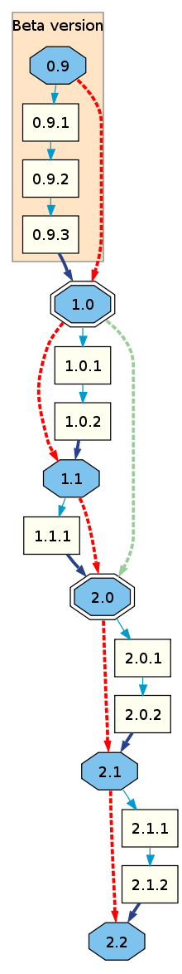
Versioning
In some cases:
Odd-numbered versions for development releases
Version 1.0 as a milestone
major.minor[.build[.revision]]
Or major.minor[.maintenance[.build]]

Slide 48
Tools
Versioning / Change management tools
CVS
Subversion
Git
Bug tracking
Bugzilla
Mantis
Redmine

Slide 49
Testing

Slide 50
Testing
Understanding and testing use-cases
Writing automated test-cases
White box / Black box / Grey box testing
Regression / Integrated / Test driven / Unit testing

Slide 51
Questions?

Slide 52

Find yourself a group
Exchange contact information
Start on the Registration assignment
Register on the course
Notify me if you can’t find a group

